Slide 1

How to Think in Code
Workshop Lead: Thomas Zheng
Date: September 22nd, 2026
Material adapted from: Larisa Morales Soto and Maria Hadid

Slide 2

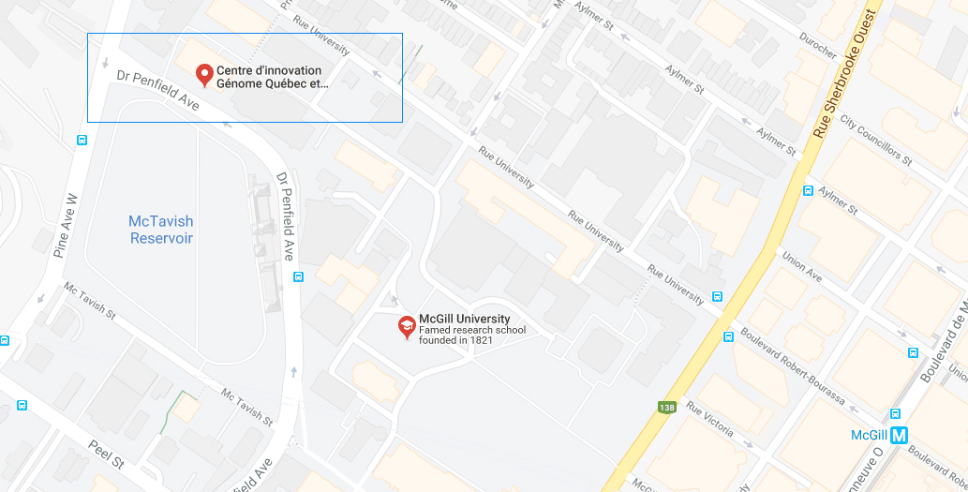
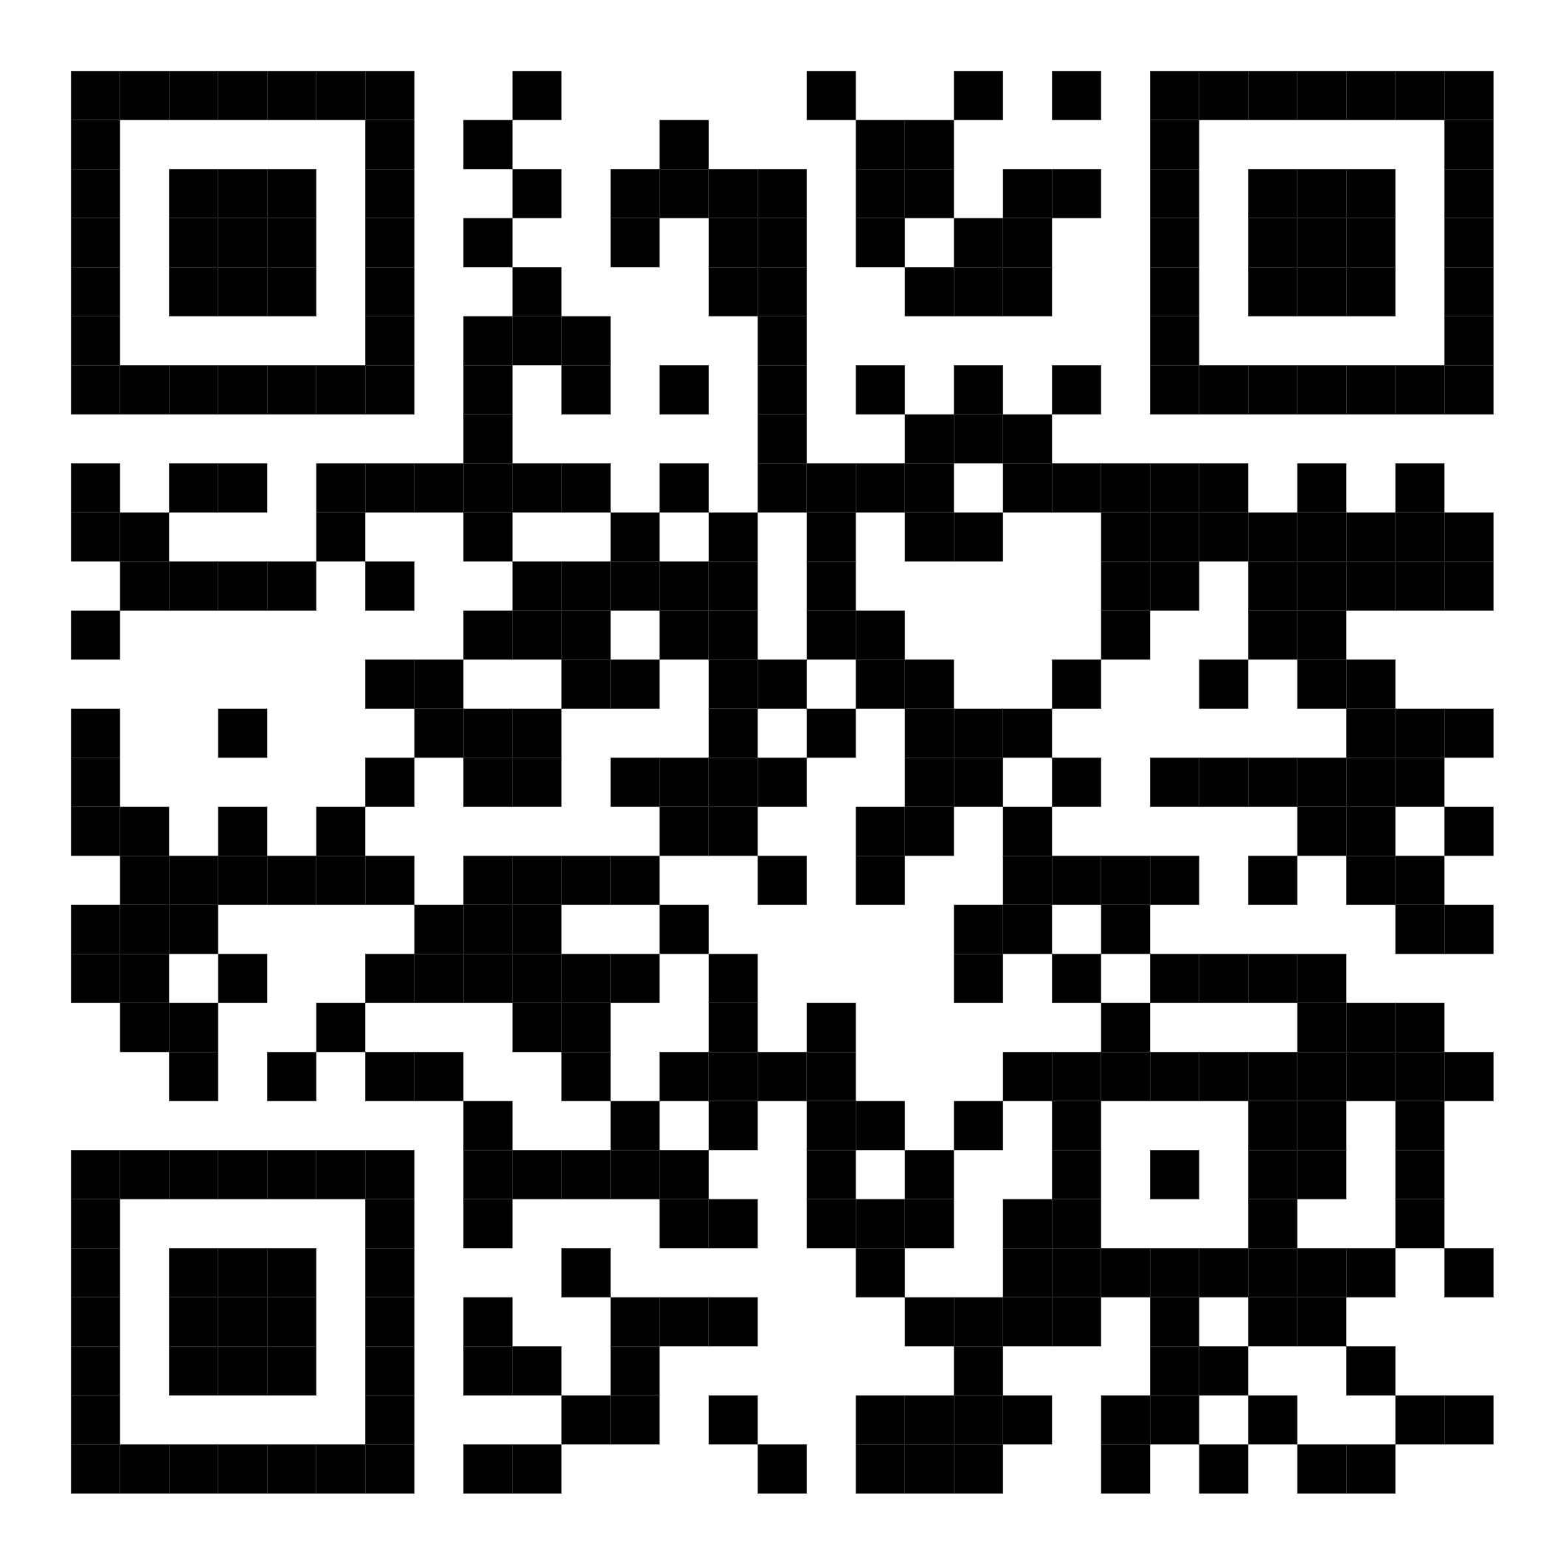
Mission statement: deliver quality workshops designed to help biomedical researchers develop the skills they need to succeed.
Location: 740 Dr. Penfield Avenue, Montreal, Quebec
Scan the QR code to sign up
for our mailing list
Contact: workshop-micm@mcgill.ca

Slide 3
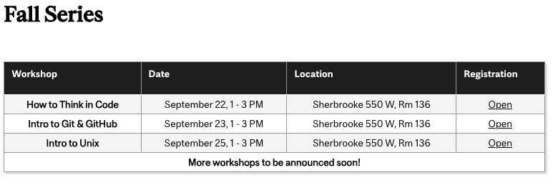
https://www.mcgill.ca/micm/training/workshops-series

Slide 4
What to expect today
Practice structured thinking
Become familiar with programming logic
Learn about basic programming components
(variables, algorithms, data structures)
Learn control structures
(loops, conditional statements, and more)
We will NOT:
Perform data analysis
Learn about machine learning
Write programs that generate visualizations

Slide 5
Contents
Part 1 – Overview of computers and programs
  What is a computer?
  What is a computer program?
Part 2 – Coding fundamentals and hands-on testing
  Basic variables and data types
  Boolean logic
  Conditional statements
  For and While loops
Part 3 – Functions and Data Structures
  Functions
  Data Structures
  Indexing

Slide 6
Part 1
What is a computer and what are programs?

Slide 7
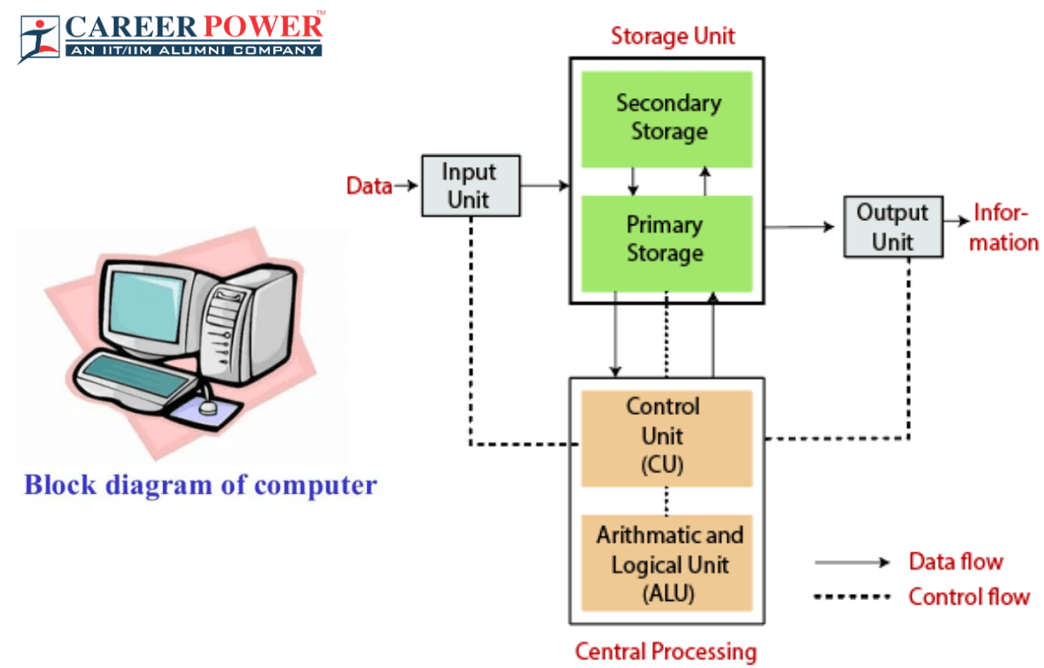
What is a computer?

Slide 8
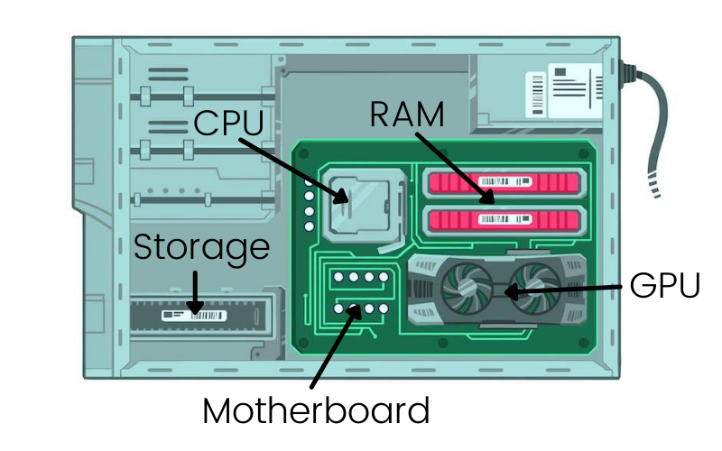
Top things a computer needs
Storage – Hard Drive
RAM – Random Access Memory
CPU – Central Processing Unit
I/O – Input and Output Devices

Slide 9

What is a computer program?
Source code
Human readable
Sequence of instructions for the computer to execute
Translation of our thoughts into operations that the computer understands
This used to be a laborious process, but now we have languages that help us!
Executable
Machine instructions

Slide 10
What is a computer program?
Source code
Human readable
Sequence of instructions for the computer to execute
Translation of our thoughts into operations that the computer understands
This used to be a laborious process, but now we have languages that help us!
Executable
Machine instructions

Slide 11
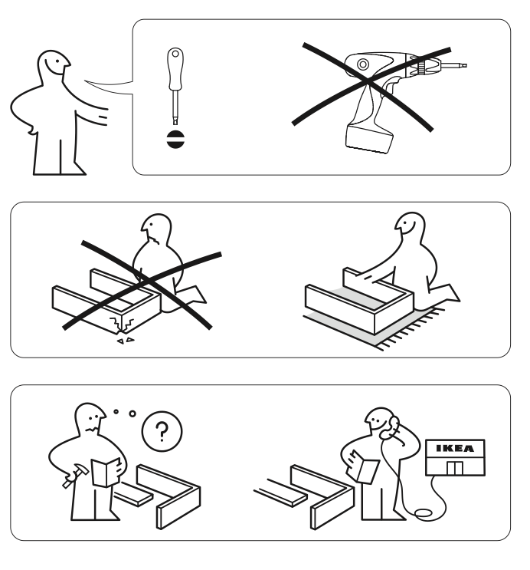

Sequence of instructions
Clear
Concise
Efficient

Slide 12
Sequence of instructions
Computers can’t read your minds!
(yet)
Clear
Concise
Efficient

Slide 13
Pseudo-code
A high-level summary of a sequence of instructions
Build twin bed
Repeat
Useful to visualize the order of steps
Serves as the backbone of the code

Slide 14

Repeating instructions
Learn how to do it once
Find the pattern
Repeat it

Slide 15

Algorithms
Precise set of instructions used for solving a problem or performing a task.
Tying your shoes
Finding a book in the library
Following a cooking recipe
Finding the shortest path
Sorting a list of numbers
Recommending digital content

Slide 16
Algorithms
Precise set of instructions used for solving a problem or performing a task.
Tying your shoes
Finding a book in the library
Following a cooking recipe
Finding the shortest path
Sorting a list of numbers
Recommending digital content

Slide 17
Hands-on 1: Exploring a coding environment!
Today, we will be using an online IDE – Integrated Development Environment
In future workshops, we will show you how to install and use one on your local computer!
https://www.online-ide.com/online_python_ide

Slide 18
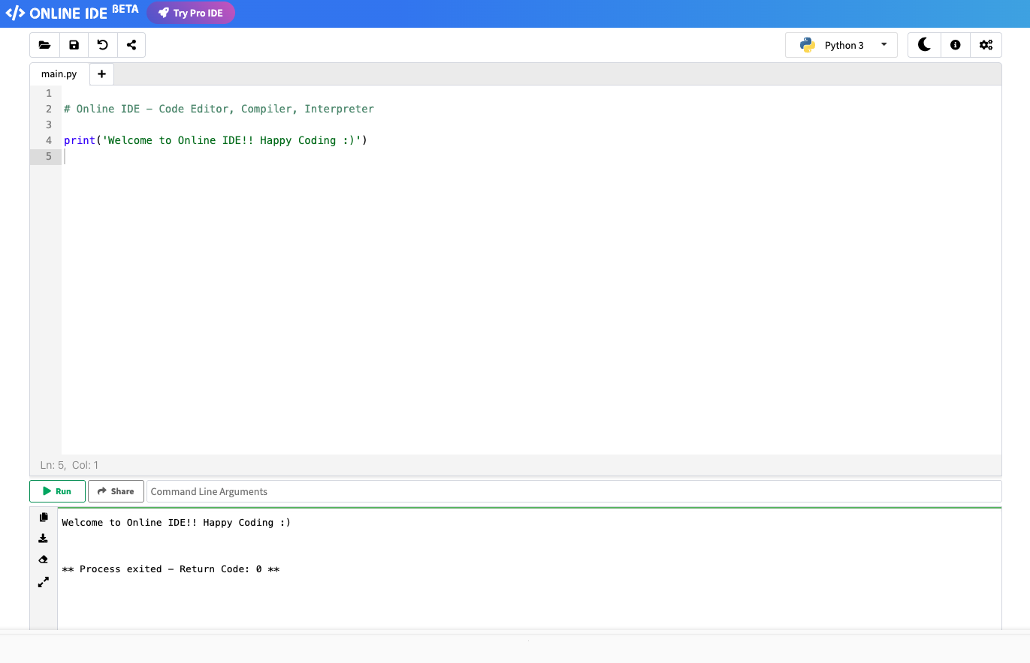
This is a comment
A leading # signifies to the IDE not to read this line

Slide 19
This is a comment
A leading # signifies to the IDE not to read this line
This is a print command
It will print any string you give it!
That’s anything in “”

Slide 20
Click on Run!

Slide 21
Click on Run!
We use Return Code as a type of “exit code”
Most times Code 0 means your program worked!

Slide 22
What happens if you remove this parenthesis?

Slide 23
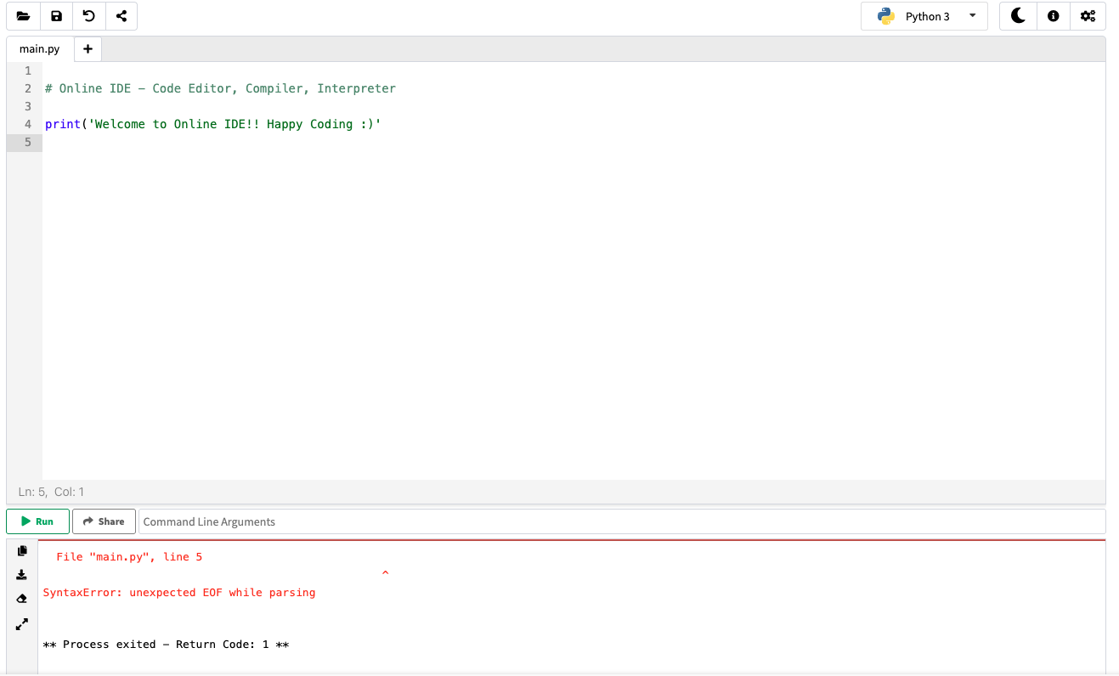
Any guesses?

Slide 25
We got an error! (Don’t panic)

Slide 26
We got an error! (Don’t panic)

Slide 28
EOF means “End of File”

Slide 29
We got a Code of 1!

Slide 30
Part 2
Coding fundamentals and Hands-on testing

Slide 31

Variables
Container to store information
needed in the program
shape = “circle”

Slide 32
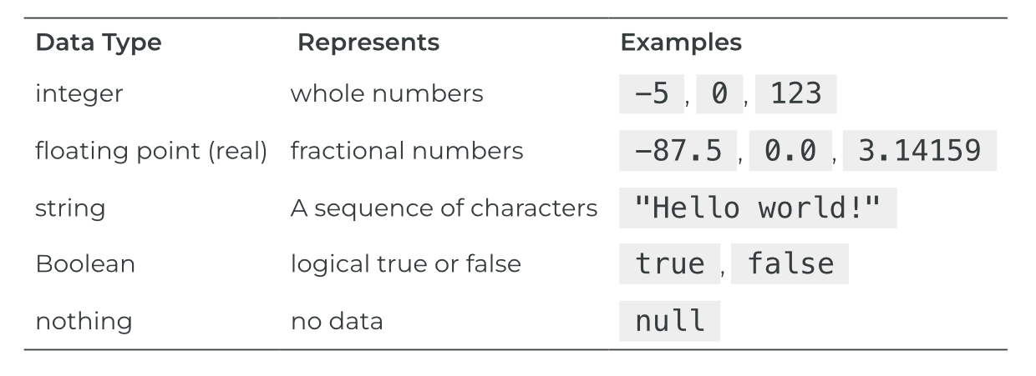
Data types
Refers to the kind of information that can be stored in a variable
TRUE
37
“dog”
Adapted from https://press.rebus.community/programmingfundamentals/chapter/data-types/

Slide 33
Before we start…
Python has a “dynamic” typing
It will guess what data type your variable is!

Slide 34
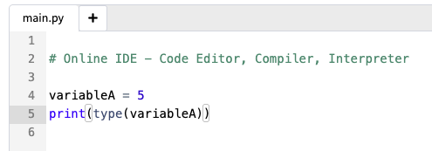
Let’s try it!
We can use the type() function to tell us what the IDE thinks it is!
Use it and the print() function to tell us what variableA is!

Slide 35
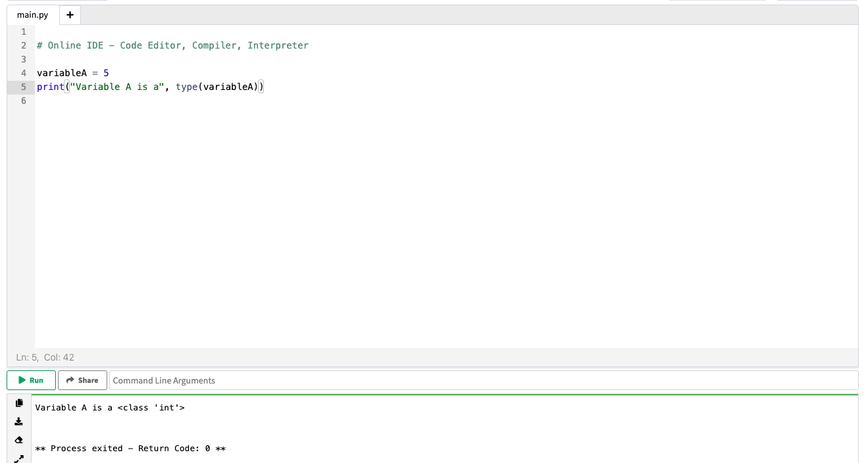
You can even make it “fancy”

Slide 36
Assign and print each type!
Python uses the keyword None
Python uses the keywords True and False not true and false

Slide 37
Data types
Refers to the kind of information that can be stored in a variable
TRUE
37
“dog”
Adapted from https://press.rebus.community/programmingfundamentals/chapter/data-types/

Slide 38

Boolean logic
A type of operation that can only have two possible outcomes:
TRUE or FALSE
Boolean expression | Result
2+2 == 5 | FALSE
“dog”==“human” | FALSE
2*2 > 1 | TRUE

Slide 39
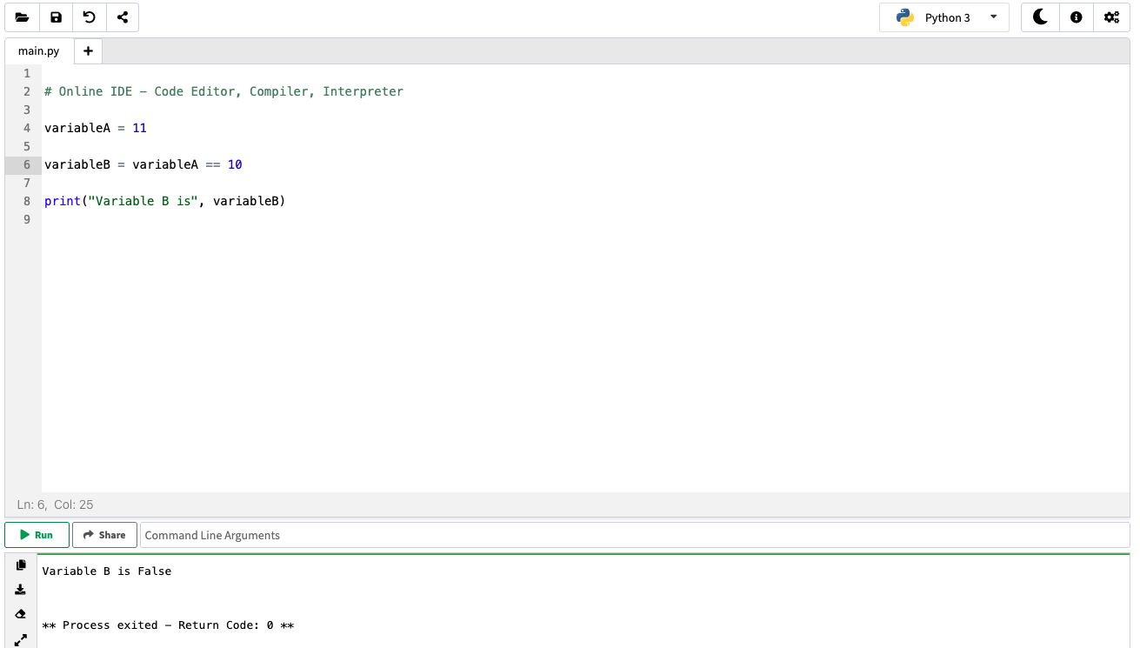
Let’s try it!

Slide 40
Boolean operators
Shape==circle
FALSE
When both expressions are TRUE
TRUE
FALSE
FALSE
AND
FALSE
TRUE
When either one or the other is true
TRUE
OR
FALSE
Checks if the expression if FALSE or not
NOT
FALSE
TRUE

Slide 41
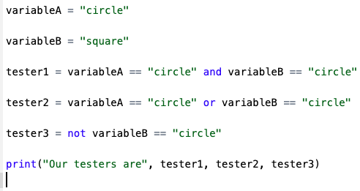

What is it like in Python?
Shape==circle
FALSE
TRUE
AND
FALSE
FALSE
TRUE
OR
FALSE
NOT
FALSE

Slide 42
Combining operators
NOT
AND
TRUE
FALSE
Shape==circle
TRUE
NOT
OR
FALSE

Slide 43
What’s the difference?
NOT
AND
TRUE
FALSE
TRUE
NOT
OR
FALSE

Slide 44
Let’s try it out in our IDE!
NOT
AND
TRUE
FALSE
TRUE
NOT
OR
FALSE

Slide 45
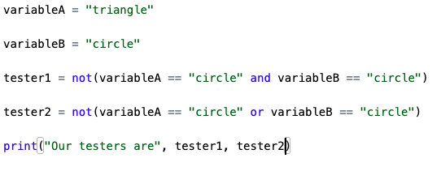
Let’s try it out in our IDE!

Slide 46
What’s the difference?
Shape==circle
NOT
AND
TRUE
When both expressions are TRUE
FALSE
TRUE
TRUE
NOT
OR
FALSE
When either one or the other is true
FALSE

Slide 47
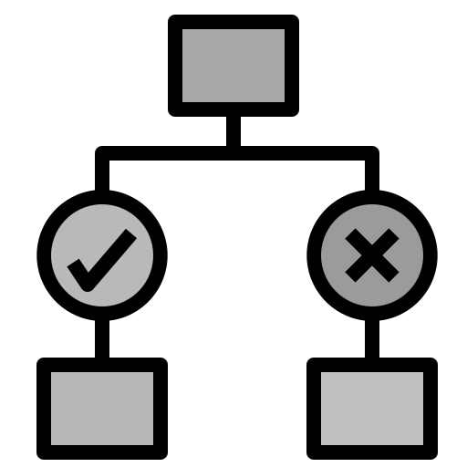
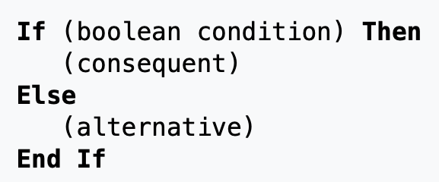
Conditionals
Command used to
make a decision and specify what to do in each case

Slide 48
Conditionals
This is known as an “if statement”:
You can even have an “else if” statement
For example:
Let us have an integer variable that can be:
Positive
Zero
Negative
We want to determine what it is!

Slide 49
Pseudocode Example:
Let us have an integer variable that can be:
Positive Zero Negative
Reminder! →

Slide 50
Pseudocode Example:
Let us have an integer variable that can be:
Positive Zero Negative
Reminder! →
If (integer < 0) Then
print(“Negative”)
Else
End If

Slide 51
Pseudocode Example:
Let us have an integer variable that can be:
Positive Zero Negative
Reminder! →
If (integer < 0) Then
print(“Negative”)
Else
End If
If (integer == 0) Then
print(“Zero”)
Else
End If

Slide 52
Pseudocode Example:
Let us have an integer variable that can be:
Positive Zero Negative
Reminder! →
If (integer < 0) Then
print(“Negative”)
Else
End If
If (integer == 0) Then
print(“Zero”)
Else
End If
If (integer > 0) Then
print(“Positive”)
Else
End If

Slide 53
Pseudocode Example:
Let us have an integer variable that can be:
Positive Zero Negative
Reminder! →
If (integer < 0) Then
print(“Negative”)
Else
End If
If (integer == 0) Then
print(“Zero”)
Else
End If
If (integer > 0) Then
print(“Positive”)
Else
End If
This works… but it could be better

Slide 54
Else If (Sometimes called Elif)
Let us have an integer variable that can be:
Positive Zero Negative
If (integer < 0) Then
print(“Negative”)

Slide 55
Else If (Sometimes called Elif)
Let us have an integer variable that can be:
Positive Zero Negative
If (integer < 0) Then
print(“Negative”)
Else If (integer == 0) Then
print(“Zero”)

Slide 56
Else If (Sometimes called Elif)
Let us have an integer variable that can be:
Positive Zero Negative
If (integer < 0) Then
print(“Negative”)
Else If (integer == 0) Then
print(“Zero”)
Else
print(“Positive”)
End If

Slide 57
Else If (Sometimes called Elif)
Let us have an integer variable that can be:
Positive Zero Negative
If (integer < 0) Then
print(“Negative”)
Else If (integer == 0) Then
print(“Zero”)
Else
print(“Positive”)
End If
Two things to keep in mind:
1) Order matters!
2) Sometimes you might want a “catch” statement

Slide 58
Else If (Sometimes called Elif)
Let us have an integer variable that can be:
Positive Zero Negative
If (integer < 0) Then
print(“Negative”)
Else If (integer == 0) Then
print(“Zero”)
Else
print(“Positive”)
End If
Two things to keep in mind:
1) Order matters!
2) Sometimes you might want a “catch” statement

Slide 59
How does order matter?
Let us have an integer variable that can be:
Positive Zero Greater than 9000
If (integer > 0) Then
print(“Positive”)
Else If (integer > 9000) Then
print(“Over 9000!”)
Else
print(“Zero”)
End If
If (integer > 9000) Then
print(“Over 9000!”)
Else If (integer > 0) Then
print(“Positive”)
Else
print(“Zero”)
End If

Slide 60
Else If (Sometimes called Elif)
Let us have an integer variable that can be:
Positive Zero Greater than 9000
If (integer < 0) Then
print(“Negative”)
Else If (integer == 0) Then
print(“Zero”)
Else
print(“Positive”)
End If
Two things to keep in mind:
1) Order matters!
2) Sometimes you might want a “catch” statement

Slide 61
What is a catch statement?
Let us have an integer variable that can be:
Positive Zero Greater than 9000
What happens if we set integer = -1?
If (integer > 9000) Then
print(“Over 9000!”)
Else If (integer > 0) Then
print(“Positive”)
Else
print(“Zero”)
End If

Slide 62
What is a catch statement?
Let us have an integer variable that can be:
Positive Zero Greater than 9000
What happens if we set integer = -1?
If (integer > 9000) Then
print(“Over 9000!”)
Else If (integer > 0) Then
print(“Positive”)
Else If (integer == 0) Then
print(“Zero”)
Else
print(“Error!”)
End If

Slide 63
What is a catch statement?
Let us have an integer variable that can be:
Positive Zero Greater than 9000
What happens if we set integer = -1?
If (integer >= 0) Then
Else
print(“Error!)
End If
If (integer > 9000) Then
print(“Over 9000!”)
Else If (integer > 0) Then
print(“Positive”)
Else
print(“Zero”)
End If

Slide 64
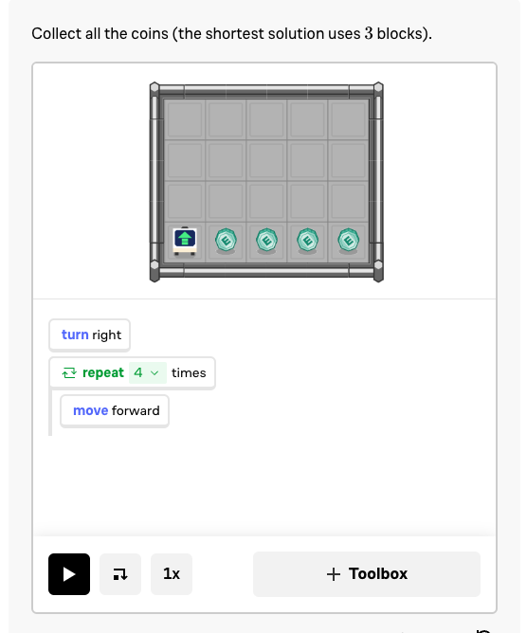
Conditional with a loop
While x is true do
  (Event)
While (space has ball){
Move forward
End While

Slide 65
While loops…
While x is > 0 do
  x = x – 1
  print(x)
End While
While x is > 0 do
  x = x + 1
  print(x)
End While
3, 2, 1, 0
3, 4, 5, 6, 7, 8, 9, 10, …, 74928403, 74928404, …

Slide 66
… can create infinite conditions
While x is > 0 do
  x = x – 1
  print(x)
End While
While x is > 0 do
  x = x + 1
  print(x)
End While
3, 2, 1, 0
3, 4, 5, 6, 7, 8, 9, 10, …, 74928403, 74928404, …

Slide 67
… can create infinite conditions
While x is > 0 do
  x = x – 1
  print(x)
End While
While x is > 0 do
  x = x + 1
  print(x)
End While
Try it yourself! Just be sure to hit the stop button or be ready to lose your webpage!
3, 2, 1, 0
3, 4, 5, 6, 7, 8, 9, 10, …, 74928403, 74928404, …

Slide 68
Part 3
Functions and
Data Structures
or... what if we know we want to do a set of actions but not as a loop?

Slide 69
Functions!
Let’s say we want to standardize an array.
  In order to do so: subtract the mean from each value and divide by the standard deviation

Slide 70
Functions!
Let’s say we want to standardize an array.
  In order to do so: subtract the mean from each value and divide by the standard deviation
How to find the mean?
  Take the sum of the array and divide by the length
  Or…

Slide 71
Functions!
Let’s say we want to standardize an array.
  In order to do so: subtract the mean from each value and divide by the standard deviation
How to find the mean?
  Take the sum of the array and divide by the length
  Or…
  mean(array)

Slide 72
Functions!
Functions allow us to do a series of commands
Instead of writing out
  Sum(numbers)/length(numbers)
  We just need to write mean(numbers)
Mean is a common function found in most languages or through a library of functions → stats functions can be found in a “statistics” library for example

Slide 73
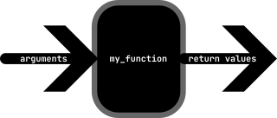
Functions!
Most functions will take some prior information called “arguments”
And will output some return values
You can even make your own functions!

Slide 74
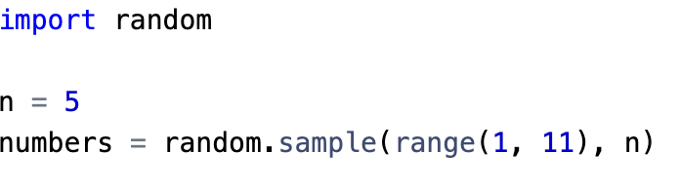
We’re going to try it now!
We’re going to import some packages in Python!
Random
Now let’s find the average!

Slide 75
Commenting
Sometimes code is hard to read if you don’t know what the coder wants/is doing
Commenting is KEY
For example, guessing a secret number
# <- This in general is the symbol for a comment – it tells the program complier to ignore the following message

Slide 76
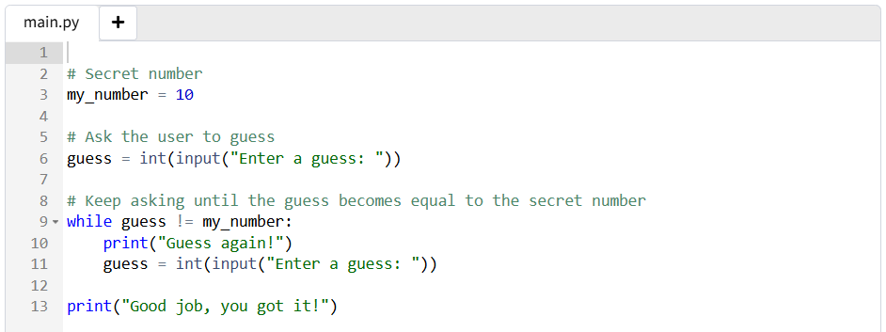

Slide 77
Hands On!
Use the Python tab!
Read comments to learn what the guess should be
Run the program first
  Try with an incorrect guess
  Then try with the correct guess
Change the secret number

Slide 78

Data structures
Specific storage formats designed for efficient data access and management

Slide 79
Lists
This gets tricky depending on the language you use
But in general – let’s say that you have a bunch of variables all involving a single patient
  Name
  BMI
  Age
  Sex
  Illness status

Slide 80
Lists
Lists work great when you have different variables
  Name – String
  BMI – Double/Float/Real
  Age – Integer
  Sex – String or Boolean (How!?!?!)
  Illness status – String, Boolean, or Integer?

Slide 81
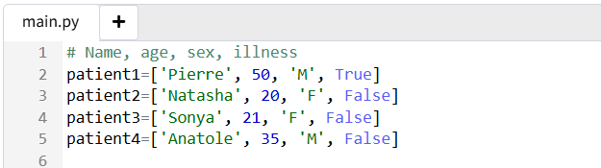
Lists

Slide 82
Arrays/Vectors
Depending on the language of choice, these are change in slight definition/usage
In general:
  These only store elements of the same type
If you have 12 patients, you can record their ages
  26, 19, 70, 45, 66, 19, 23, 25, 4, 0, 22, 26

Slide 83
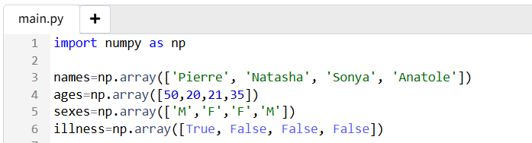
Arrays/Vectors

Slide 84
Arrays/Vectors
These are not forced to be just 1 dimensional
Sometimes these are called dataframes:
  Rows are individual patients
  Columns are different variables: age, sex, illness, etc.

Slide 85
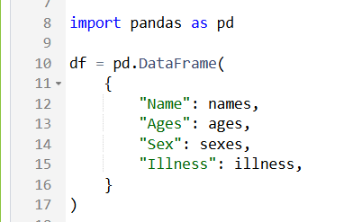
Arrays/Vectors
These are not forced to be just 1 dimensional
Sometimes these are called dataframes:
  Rows are individual patients

Slide 86
Indexing
numbers = [1,2,3,4]
When you want to grab an element from an array you can type: numbers[i]
BUT many programs (like Python) start at position 0
(zero-based indexing)

Slide 87
Indexing
numbers = [1,2,3,4]
When you want to grab an element from an array you can type: numbers[i]
BUT many programs (like Python) start at position 0
(zero-based indexing)
Numbers[1] → 2, not 1
Numbers[0] → 1

Slide 88
Final hands-on practice
On the IDE from https://codehs.com/ide
Turn my_number into an array with more than 1 element
  (Hint: the syntax you use is my_number = [x,y,z])
Change the while statement to check for a new variable my_number[i]
Using an if else statement, change the index i at each iteration

Slide 89
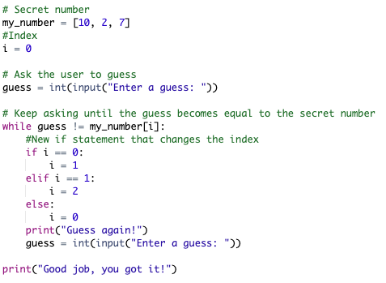
Solution

Slide 90
In summary
Practice structured thinking
Become familiar with programming logic
Learn about basic programming components
Now you are ready to:
Learn a specific programming language
Perform data analysis
Learn about machine learning
Write programs that generate visualizations

Slide 91

Feedback is appreciated!

